Slide 1
Azure VHD Upload and attach

Slide 2
Azure VHD Upload and attach
Create VHD
Copy files into VHD
Detach VHD from local
Upload VHD into Azure Blob Storage using AZCOPY
Create Disk from VHD
Attach Disk to Virtual Machine
Detach Disk From Virtual Machine
Delete VHD

Slide 3
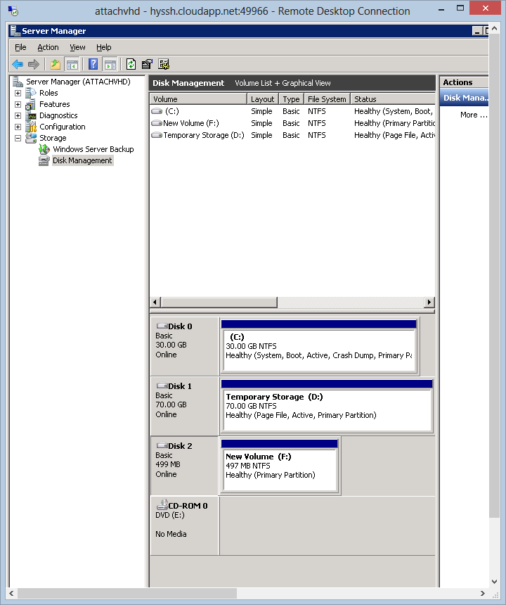
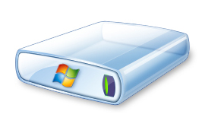
Process Overview
On-premise
Windows Azure
Virtual Machine
1
Upload VHD
.VHD
3
Attach Disk
2
Create Disk
.VHD
Windows Azure Blob Storage

Slide 4
Before Start
Find good file upload tool
For example AZCopy
For detail, link
Install AZCopy from Github
It will help you upload VHD from on-premise to Azure
How to run AZCopy
AzCopy.exe <Source> <Destination> [filepattern [filepattern…]] [Options]

Slide 5
Create VHD

Slide 6
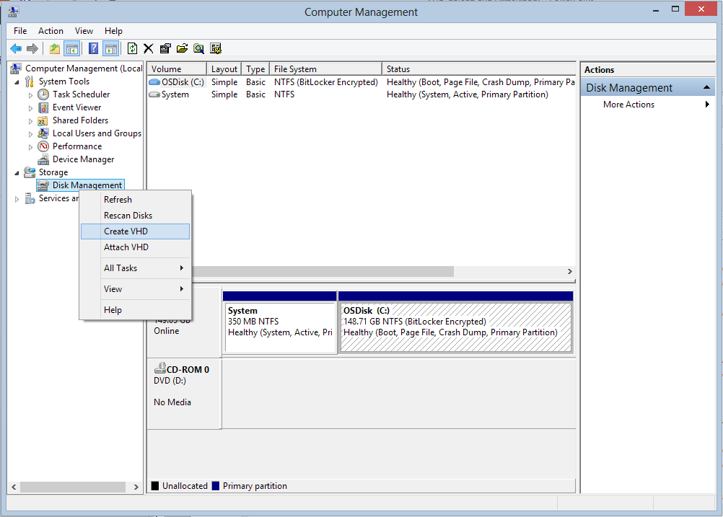
Create a empty VHD at your local machine

Slide 7
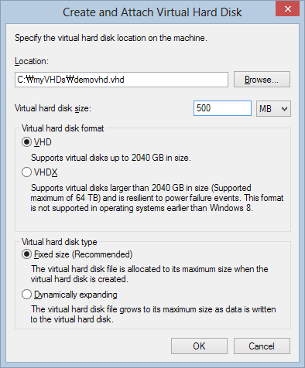
Should be smaller than 1TB
Choose VHD
Fixed Size must be chosen

Slide 8
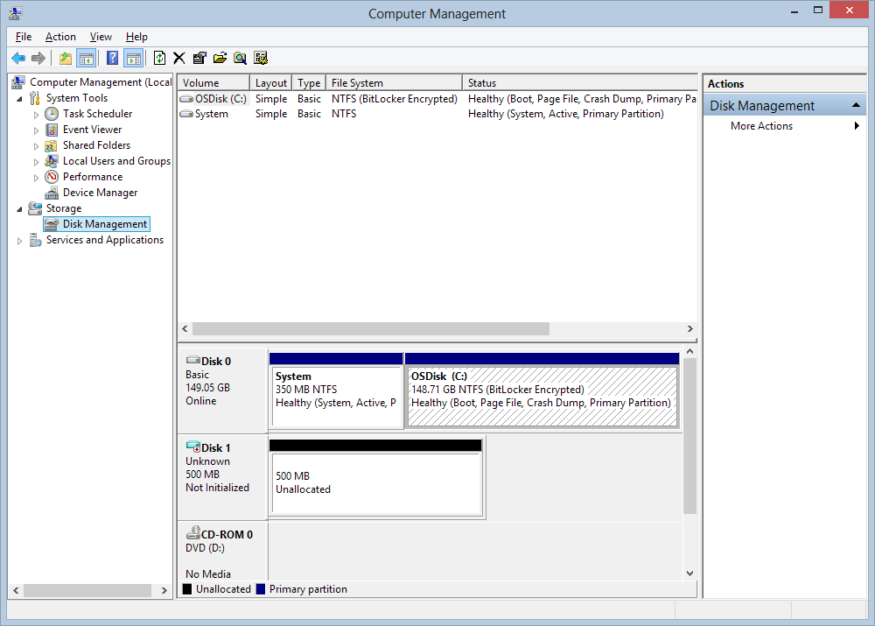
New volume is added automatically

Slide 9
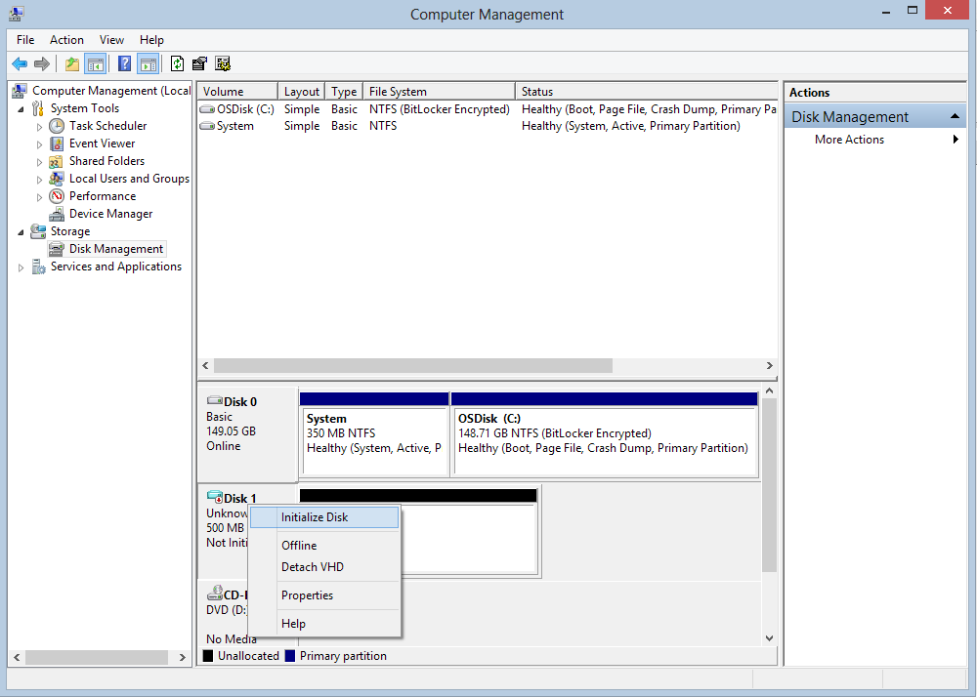
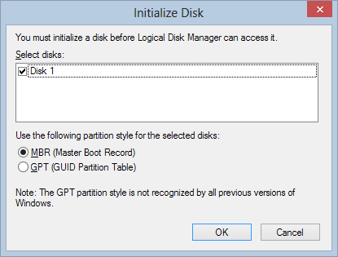
Initialize Disk

Slide 10
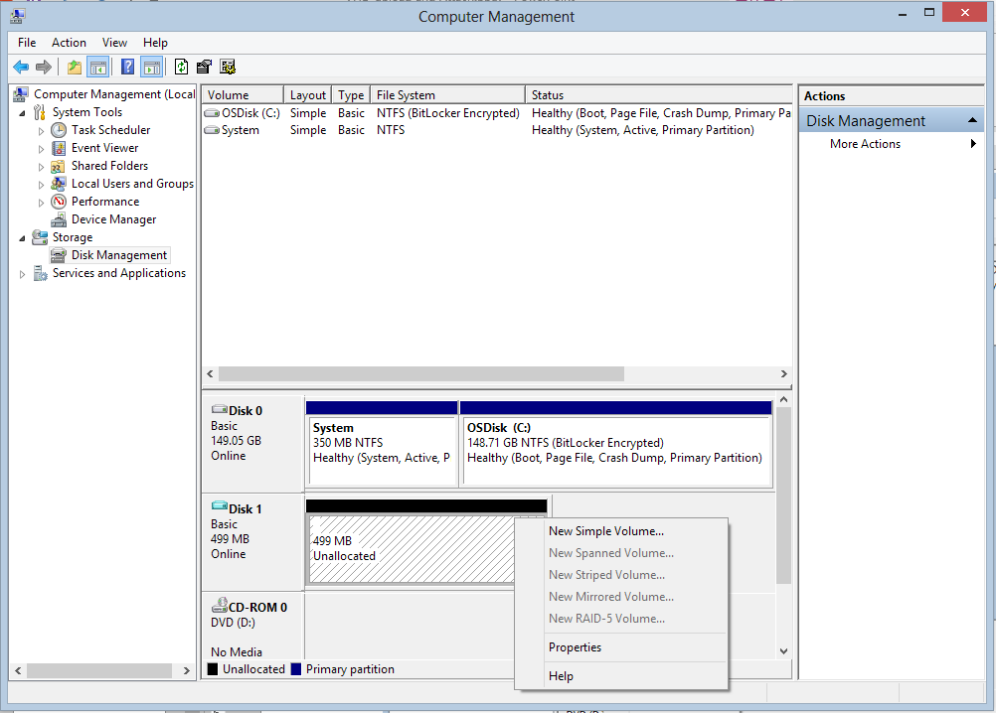
Create new simple volume

Slide 11
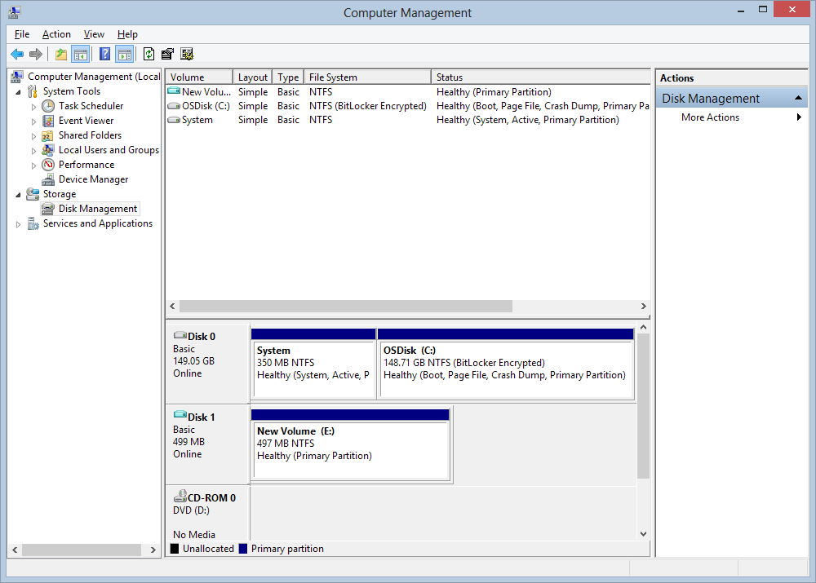
Now you are ready to use new volume

Slide 12
Copy files into VHD

Slide 13
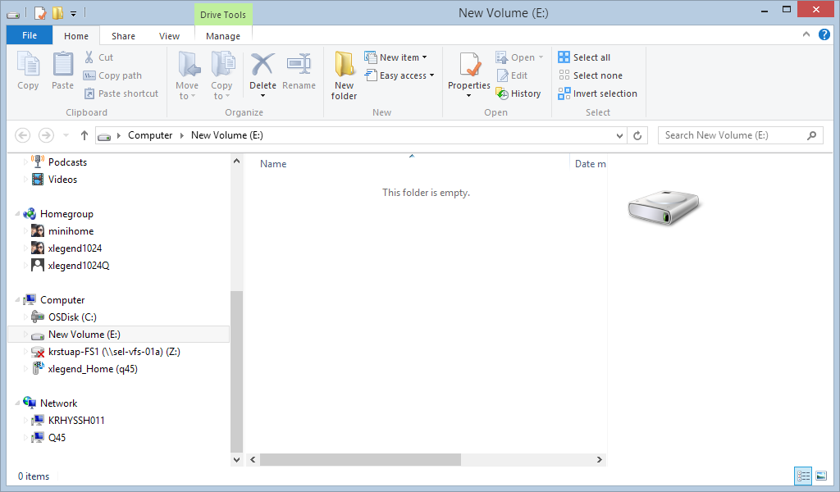
New volume which is VHD on your computer is ready

Slide 14
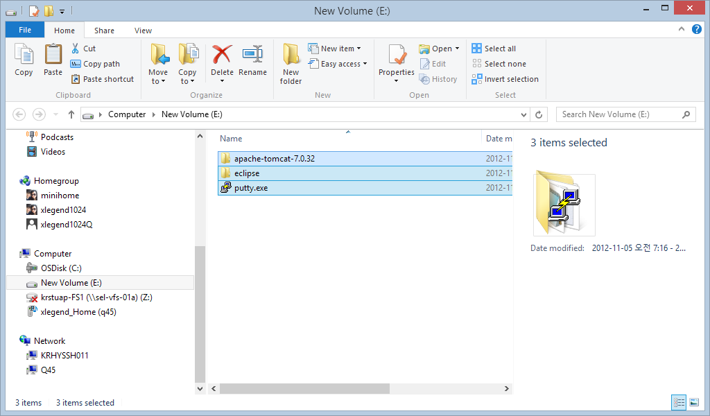
Copy files

Slide 15
Detach VHD from local

Slide 16

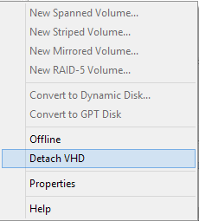
To upload VHD file, it should be detached

Slide 17
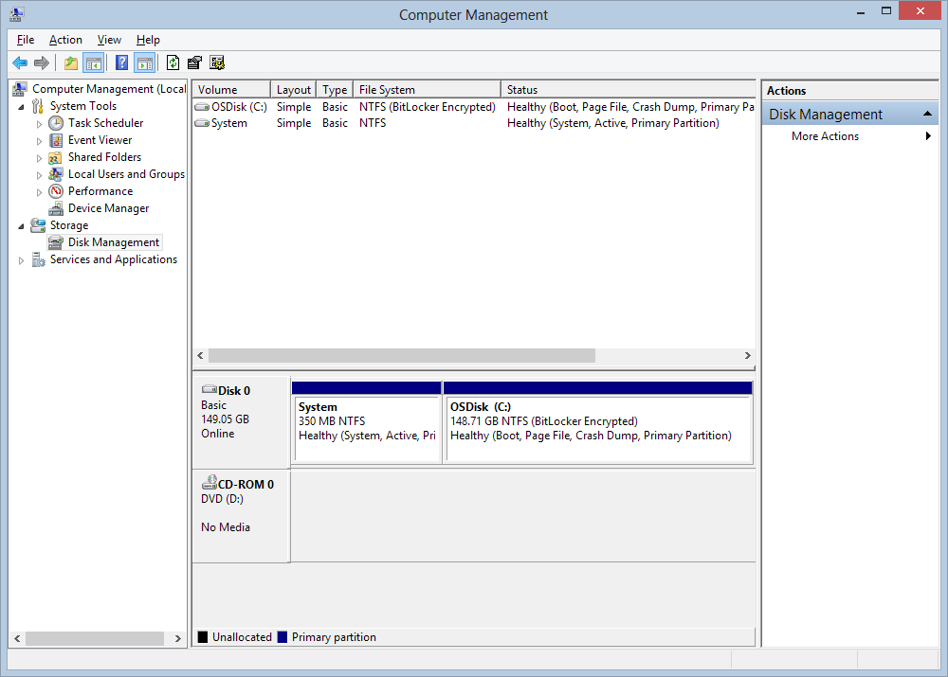
Detach is completed

Slide 18
Upload VHD into Azure Blob Storage using AZCOPY

Slide 19
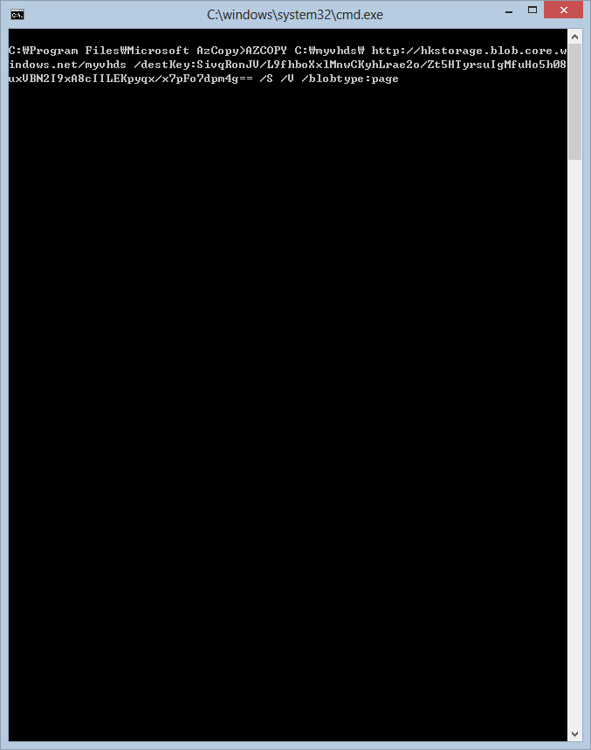
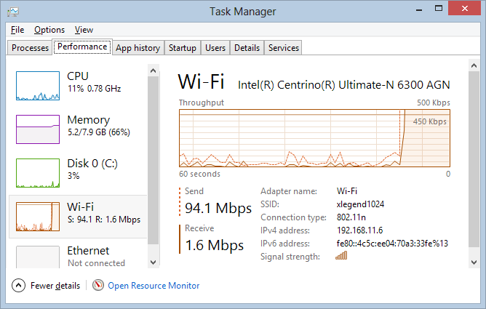
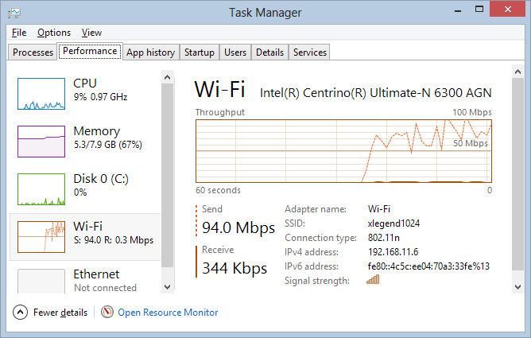
Azcopy provide fast upload so that you can save time
Use Azcopy to upload your VHD
AZCOPY
C:\myvhds\
http://hkstorage.blob.core.windows.net/myvhds
/destKey:yourblobstoragekey
/S
/V
/blobtype:page
Blobtype should be specified

Slide 20
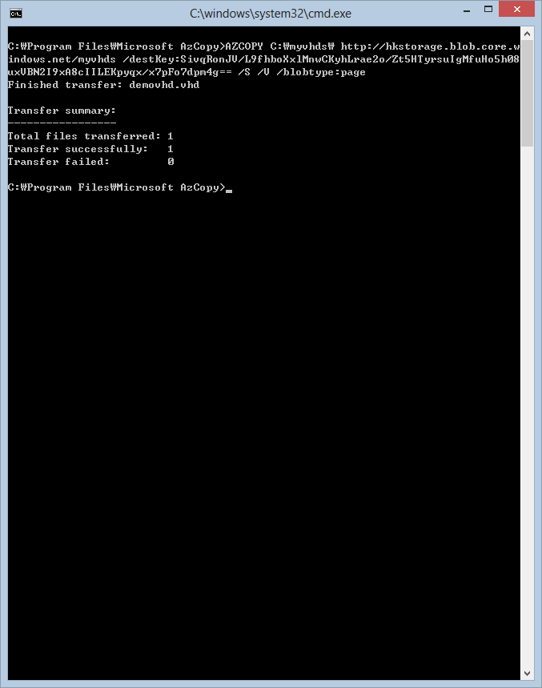
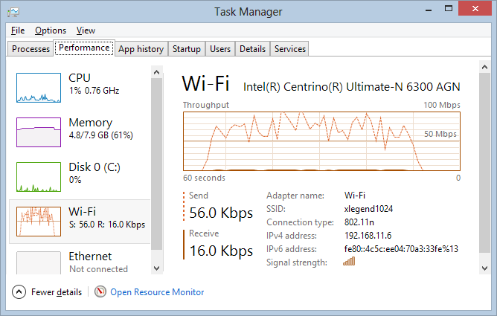
Upload is completed

Slide 21
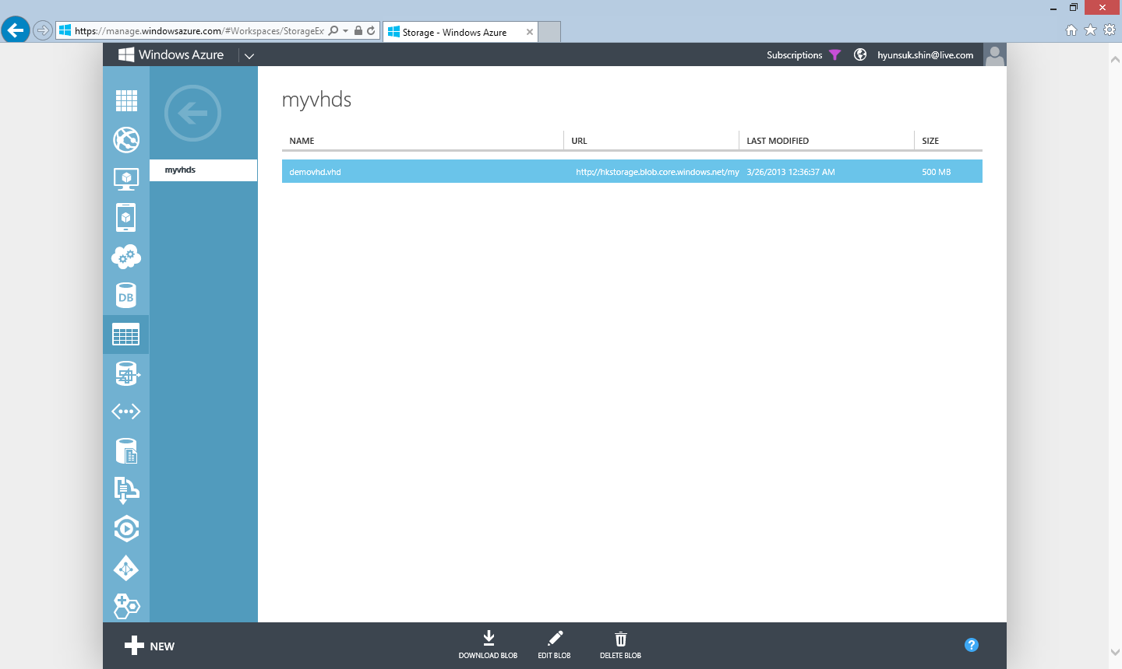
Confirm the file is upload correctly

Slide 22
Create Disk from VHD

Slide 23
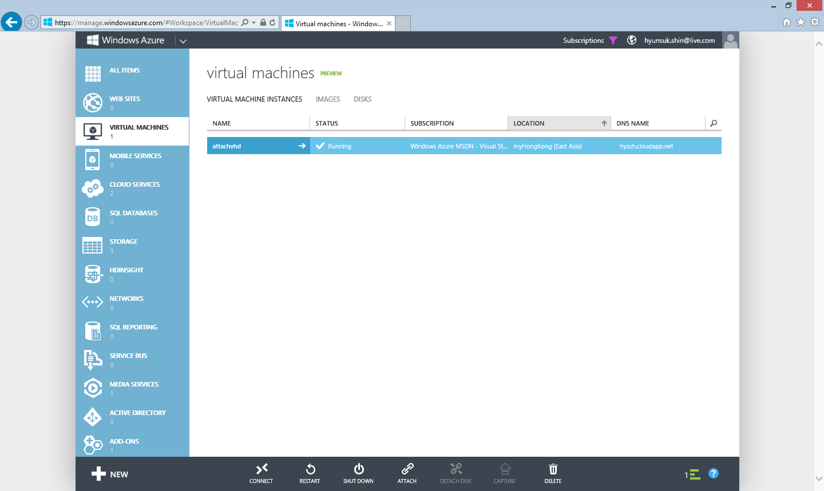
Before attach the VHD, VHD should be resisted as a Disk

Slide 24
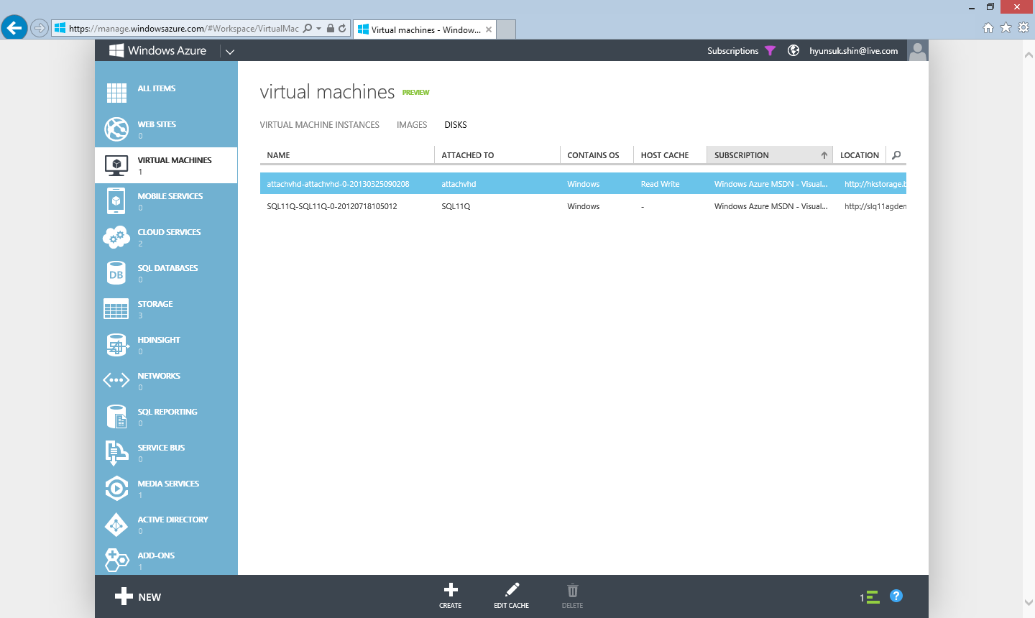
Uploaded VHD is not on the list

Slide 25

Click CREAT button to create a Disk

Slide 26
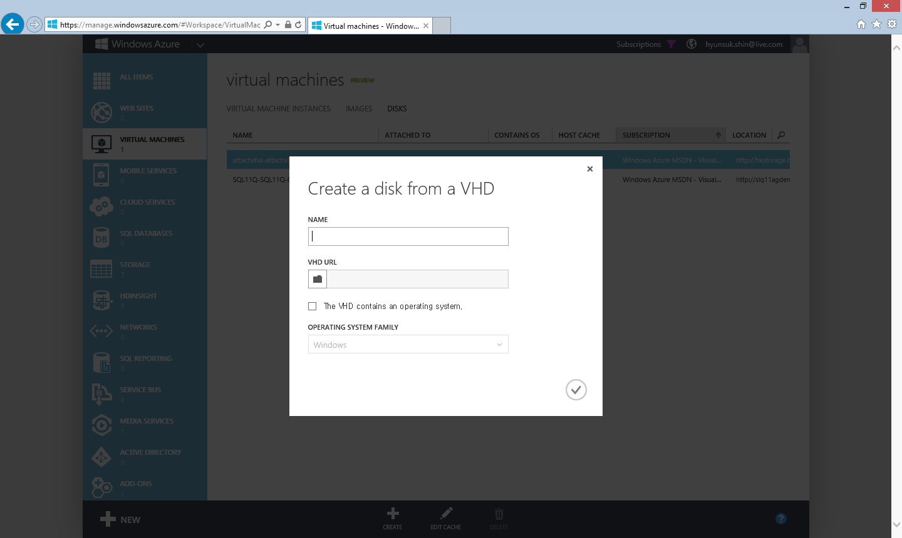
Name will be shown at Disks, can be different with name of VHD

Slide 27

Find VHD file

Slide 28
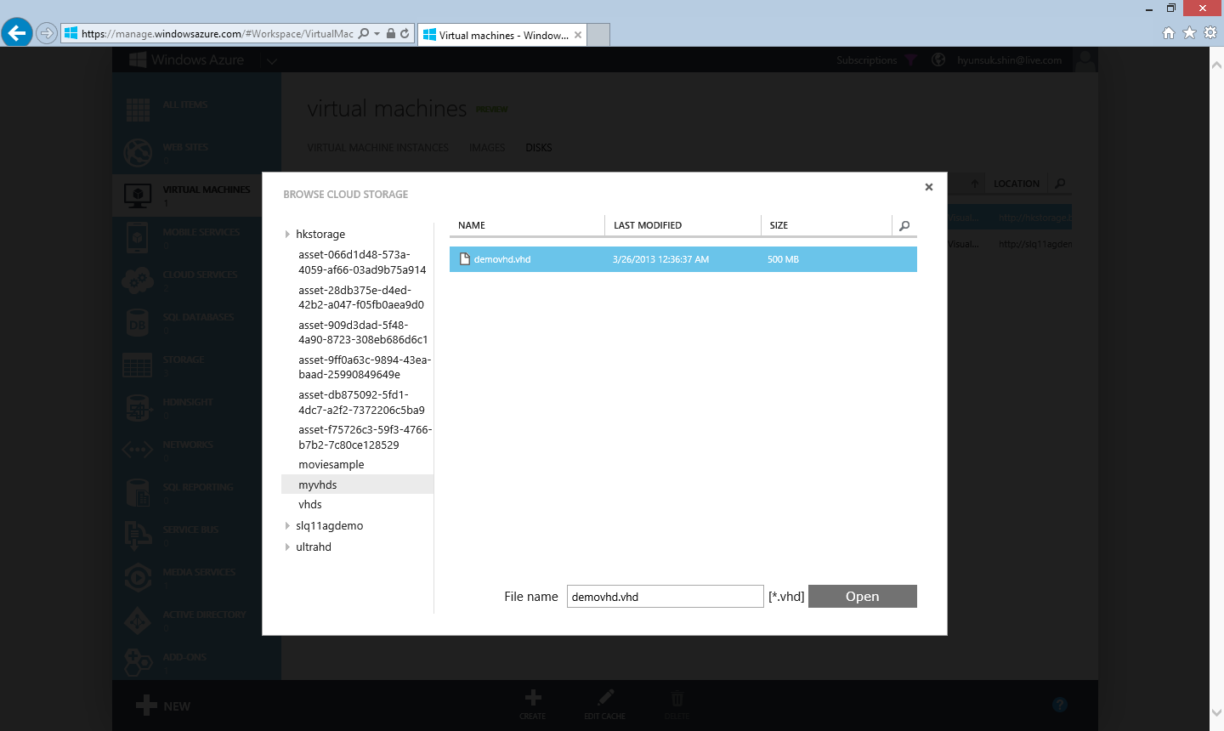
Select the uploaded file

Slide 29

VHD has only file you need, leave this checkbox

Slide 30

By clicking the button, creating a Disk job will start

Slide 31
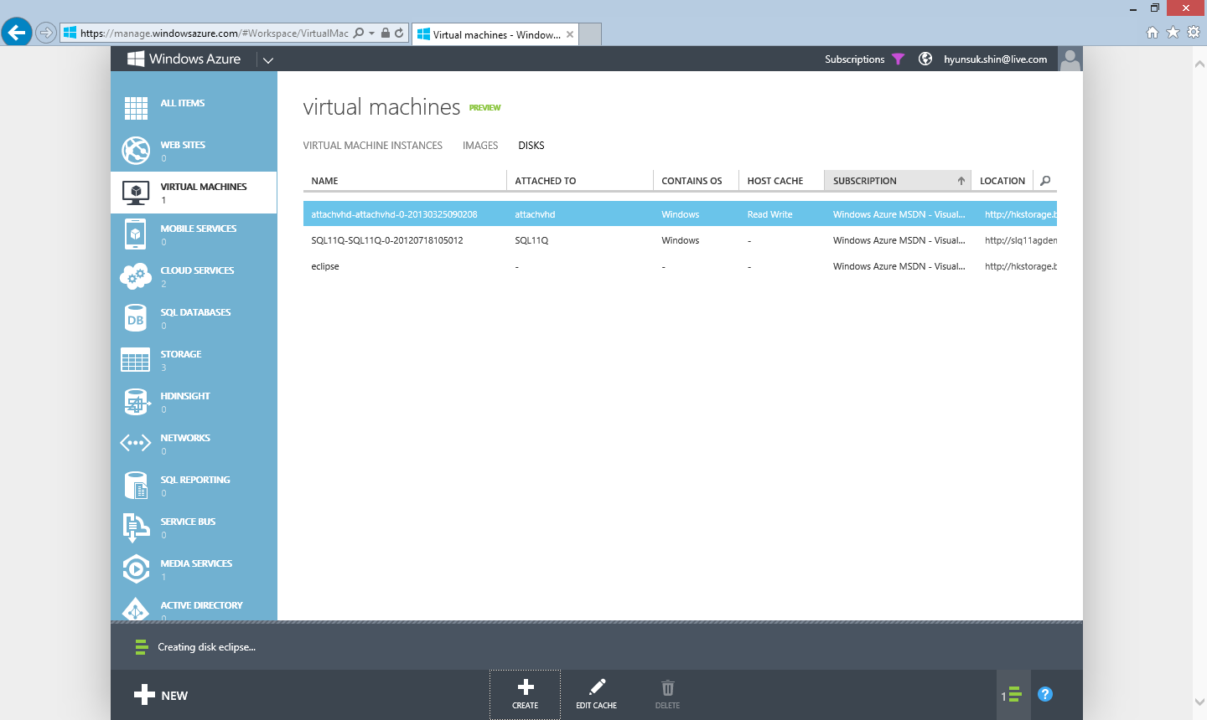
Name can be seen as a Disk

Slide 32

Now the VHD is ready to be used as a Disk for a VM

Slide 33
Attach Disk From Virtual Machine

Slide 34

To attach a Disk, go to Virtual Machines section

Slide 35
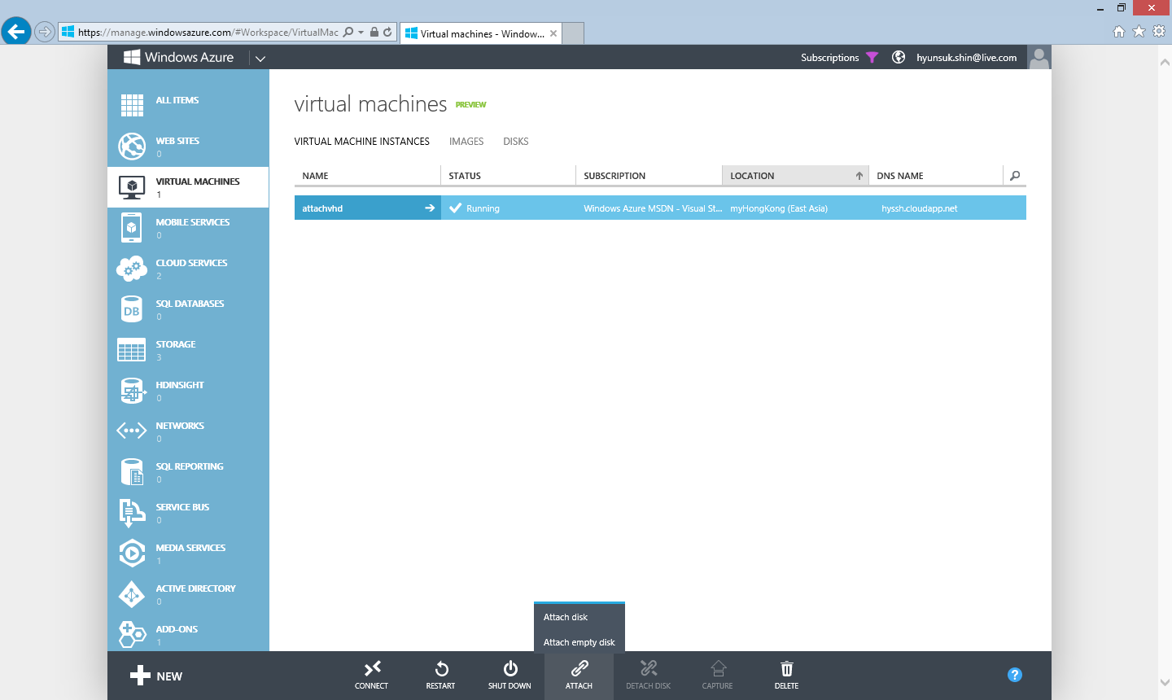
Click “ATTACH” and then click “ATTACH DISK”

Slide 36
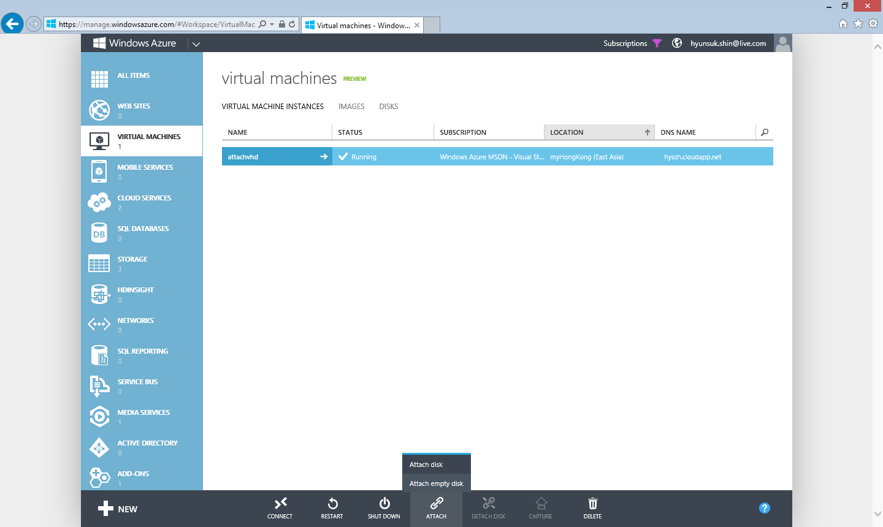
Click “ATTACH” and then click “ATTACH DISK”

Slide 37
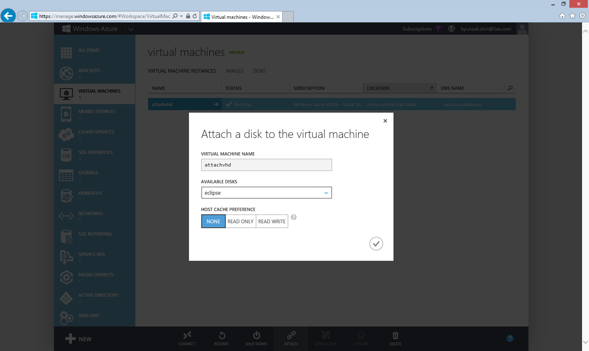
Confirm name of virtual machine
Select Disk

Slide 38
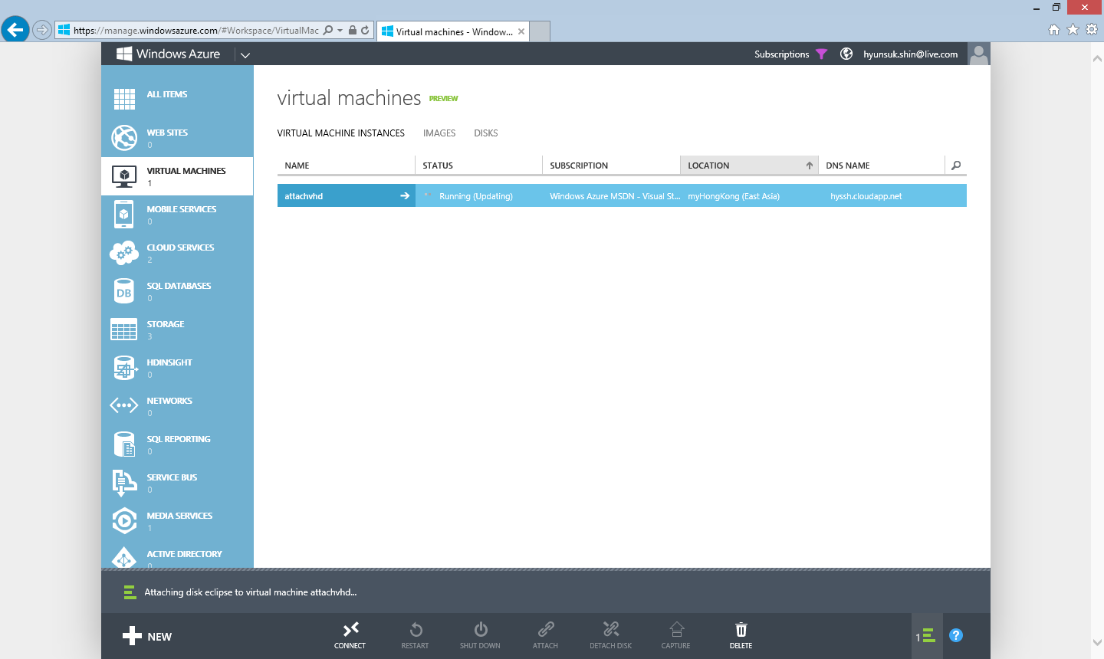
A job automatically start to add new Disk to the virtual machine you selected

Slide 39

The job is done, Ready to use new disk

Slide 40
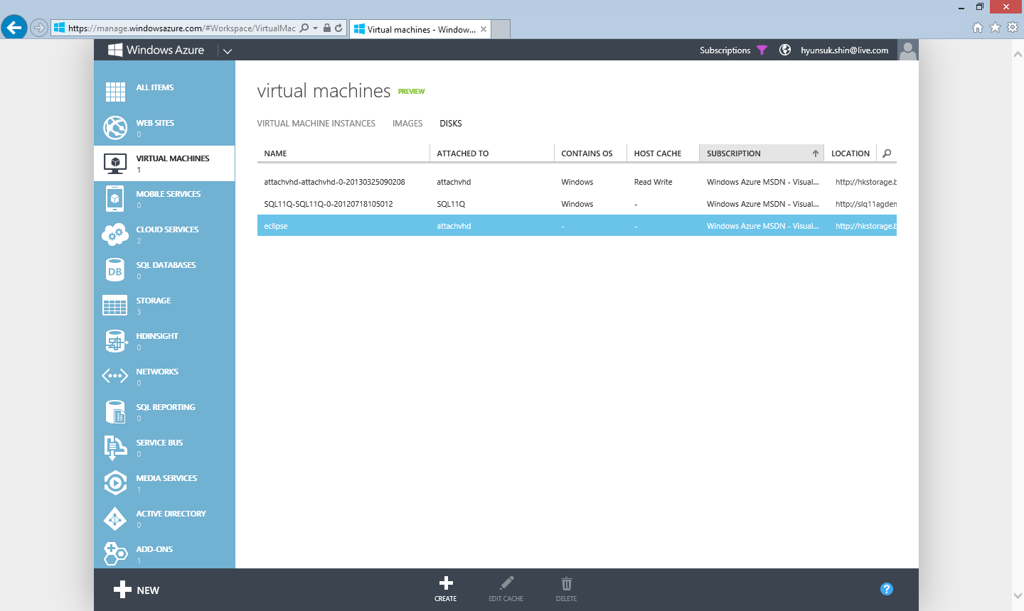
Once disk is attached to virtual machine, disk shows where it attached to

Slide 41
Check Files

Slide 42

To check and copy file from VHD to virtual machine, connect to virtual machine using remote desktop

Slide 43
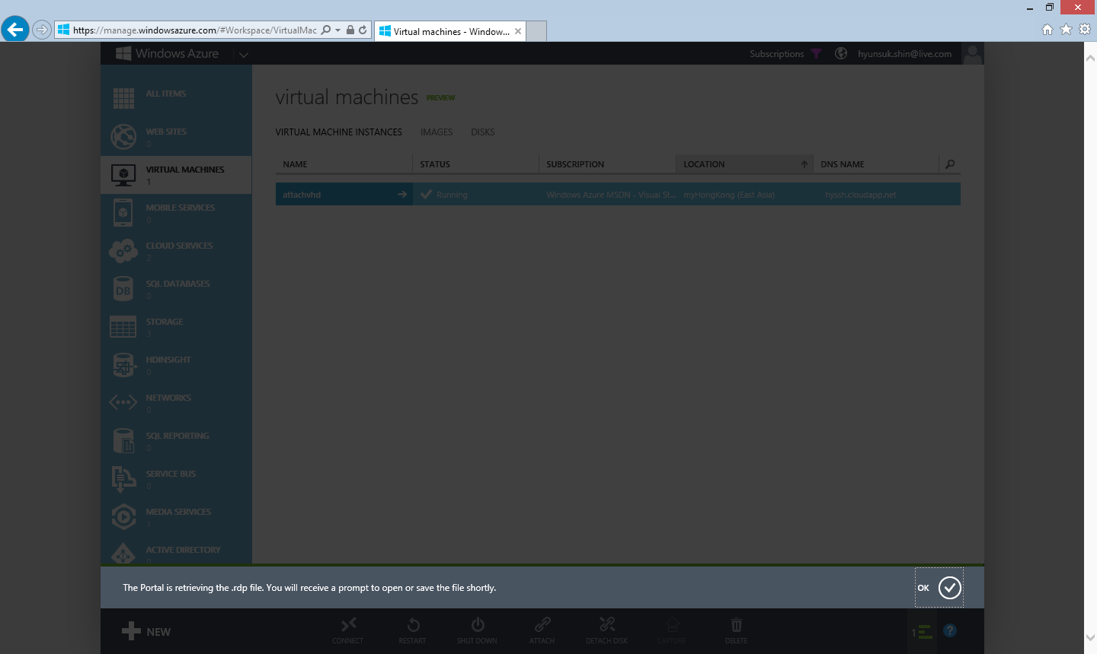

Slide 44
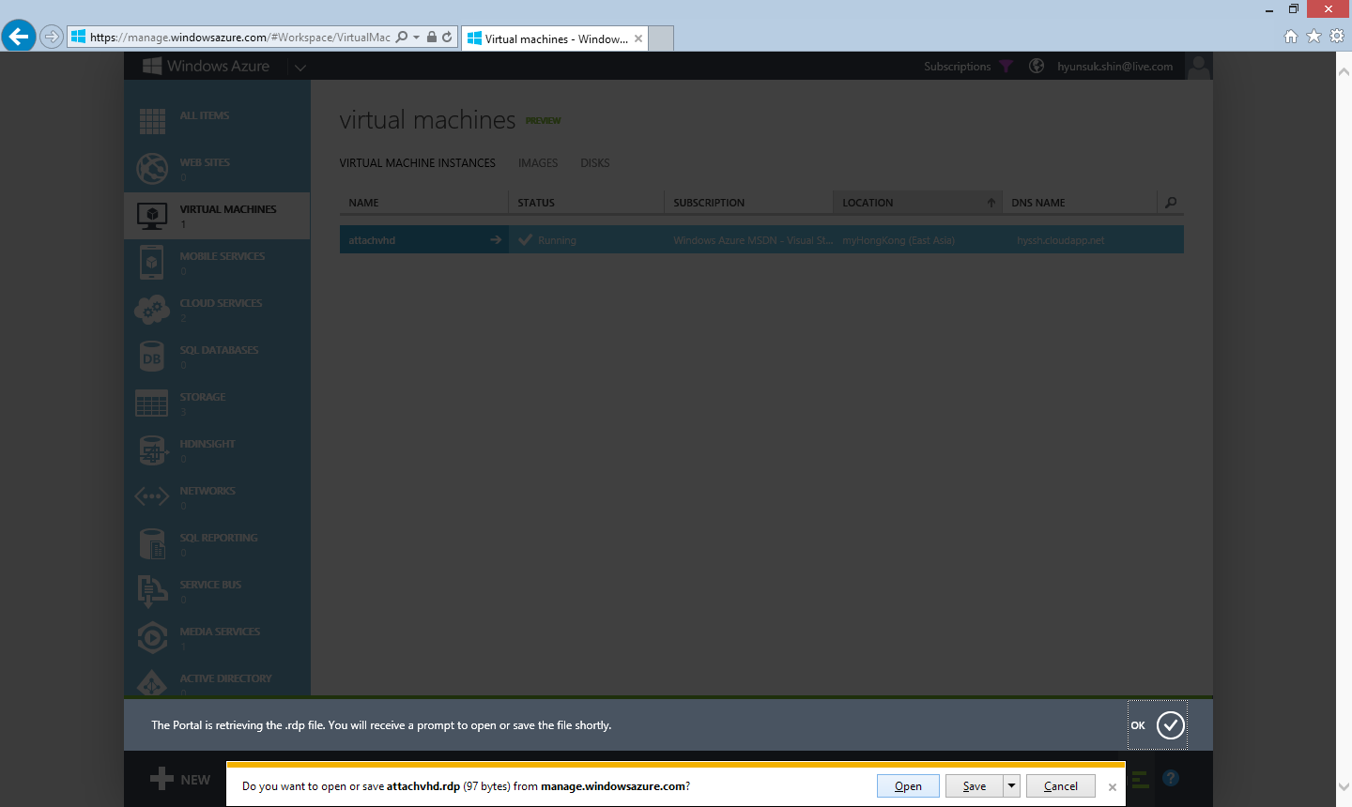
By clicking Open, remote desktop starts

Slide 45
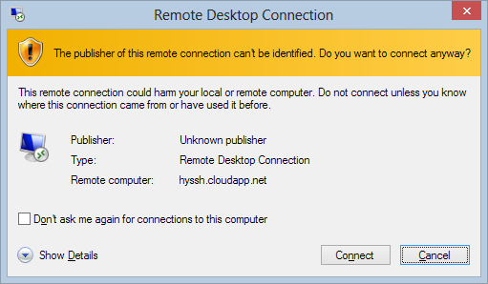
Click Connect

Slide 46
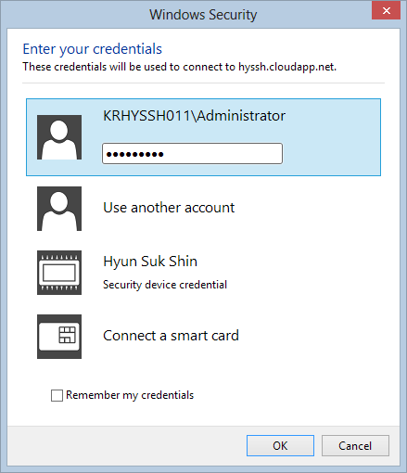
Type your password

Slide 47

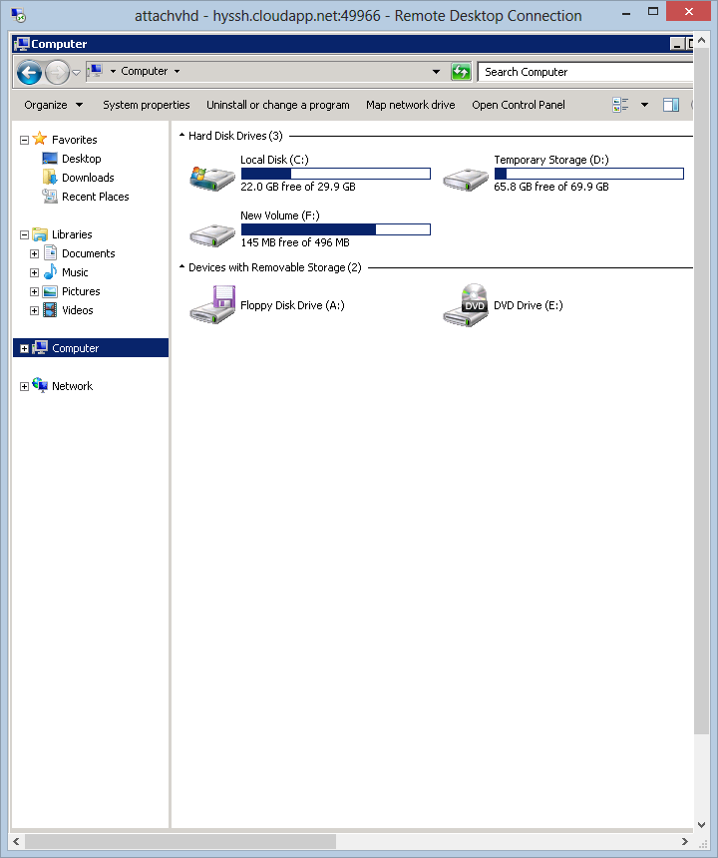
New volume can be found on the virtual machine
Volume is ready to use

Slide 48
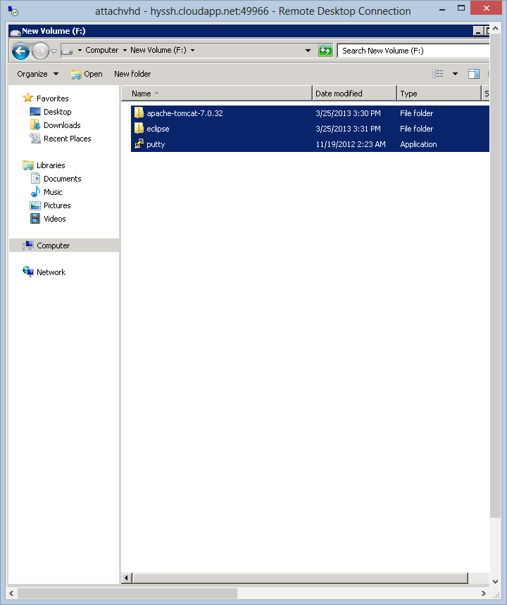
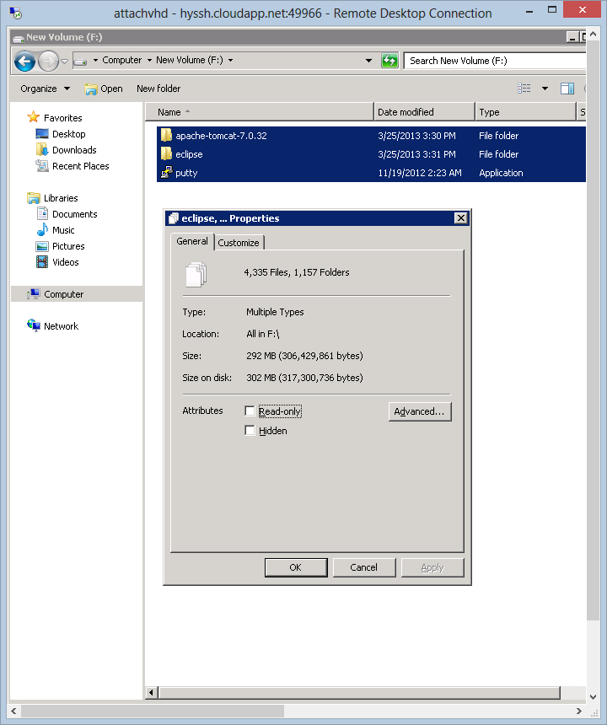
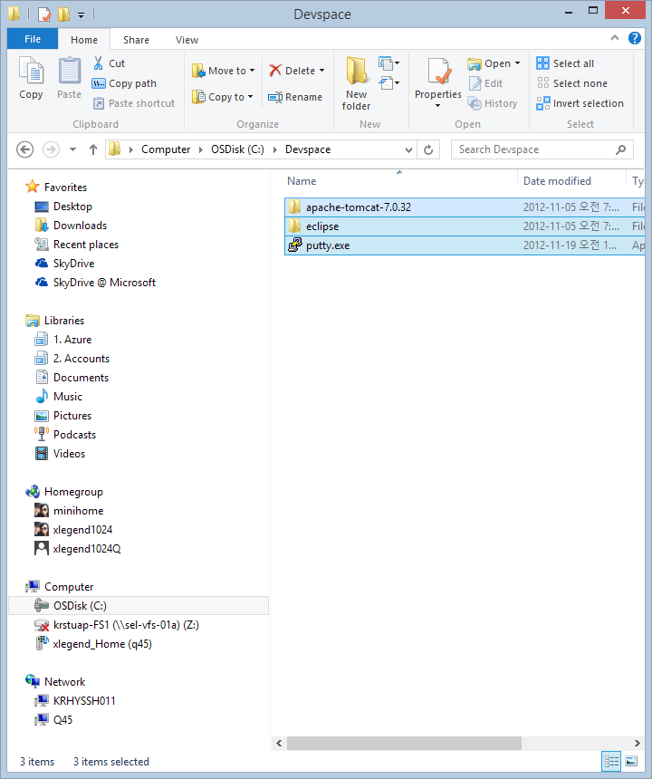
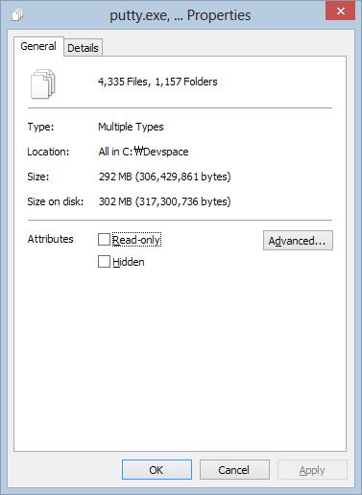
Copied files on VHD
Original files on on-premise

Slide 49
Detach Disk From Virtual Machine

Slide 50

To detach Disk, go to virtual machines menu

Slide 51

“DETACH DISK” help you detach a disk from selected virtual machines

Slide 52
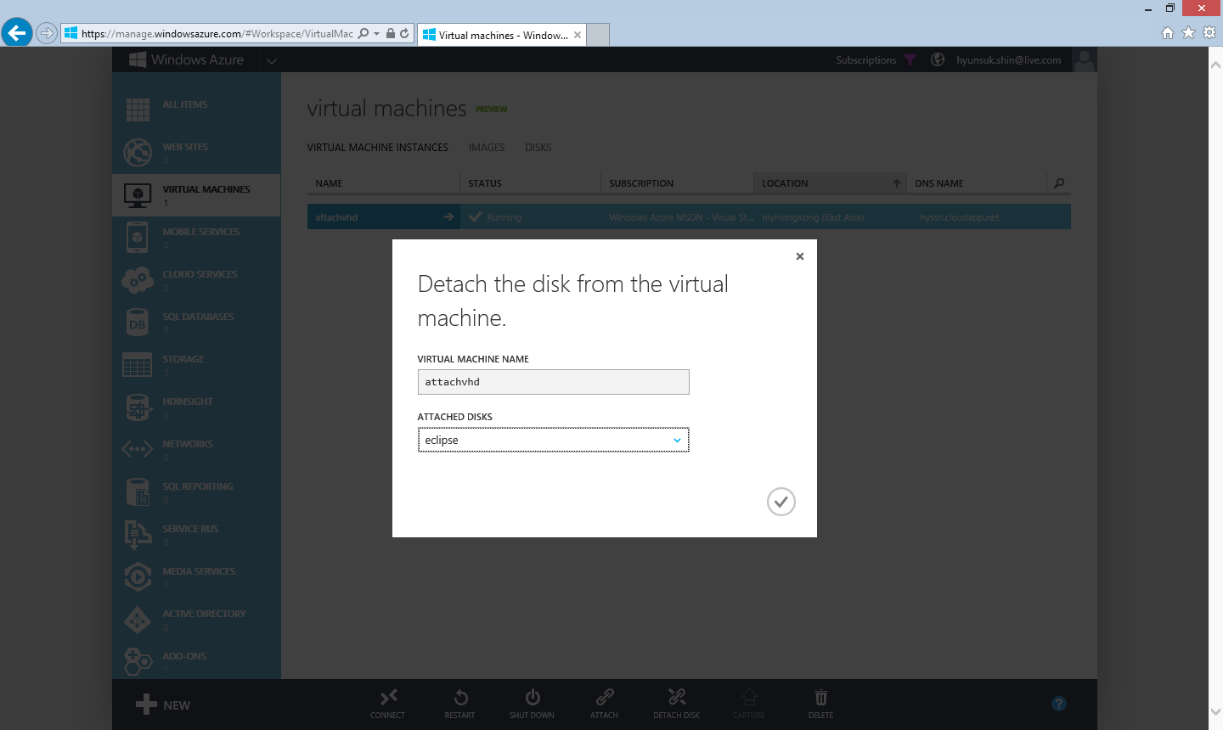
Confirm virtual machine name
Confirm disk that you want to detach

Slide 53

A new job will start to detach Disk from your selected virtual machines

Slide 54
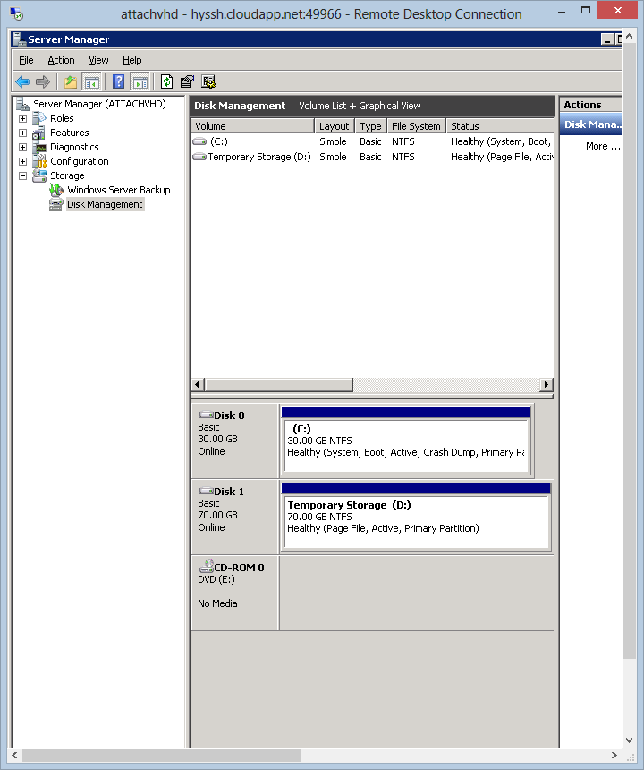
A disk was attached
A disk is detached

Slide 55
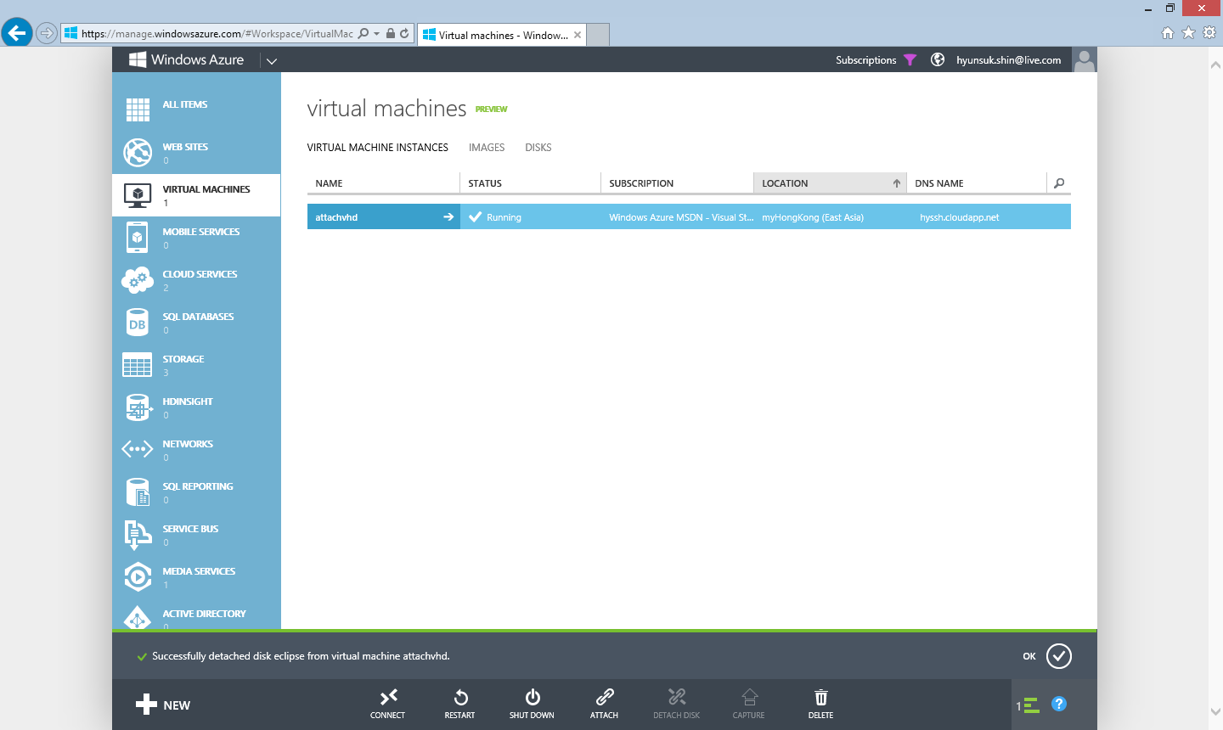
Successfully done

Slide 56
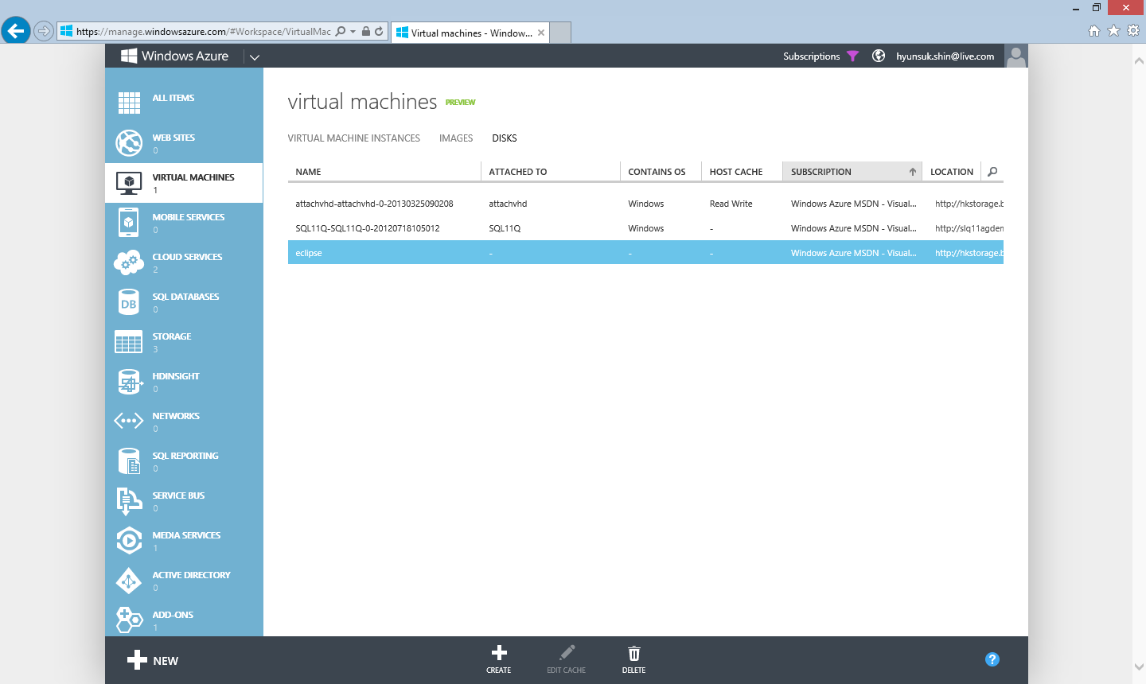
No more name at “ATTACHED TO” list

Slide 57
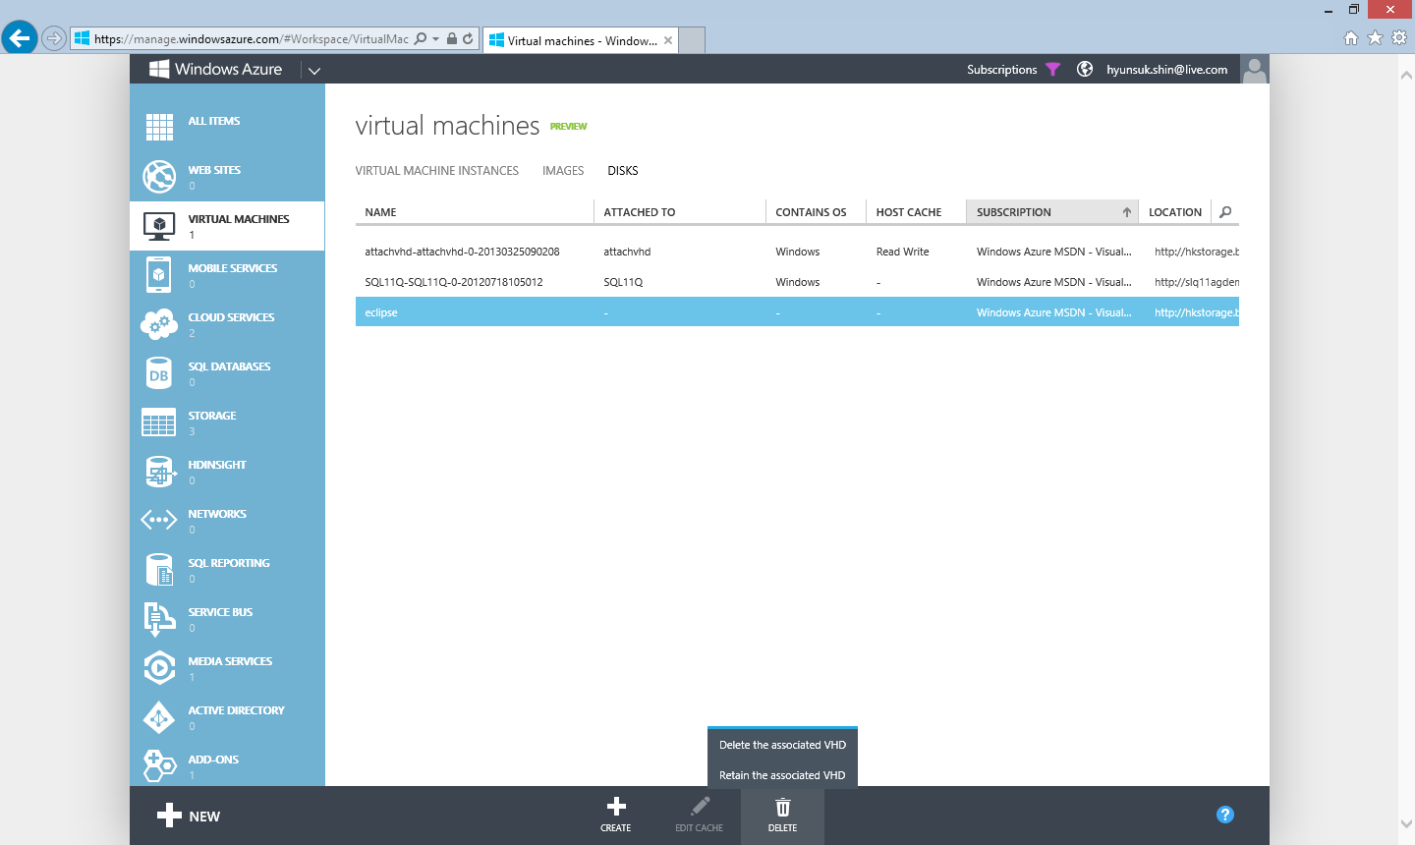
By clicking this options, selected Disk will be removed but VHD file will remained

Slide 58
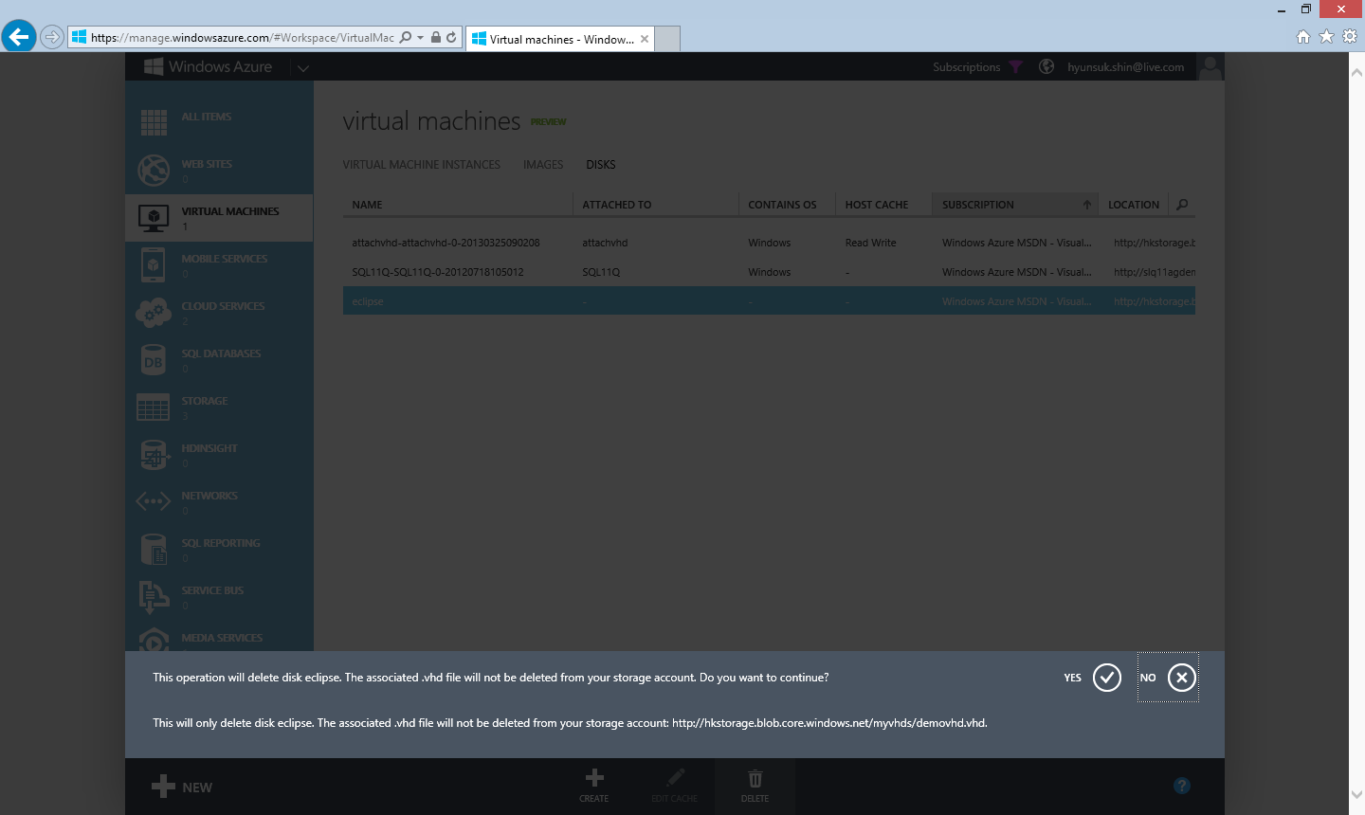
Confirm name of file

Slide 59
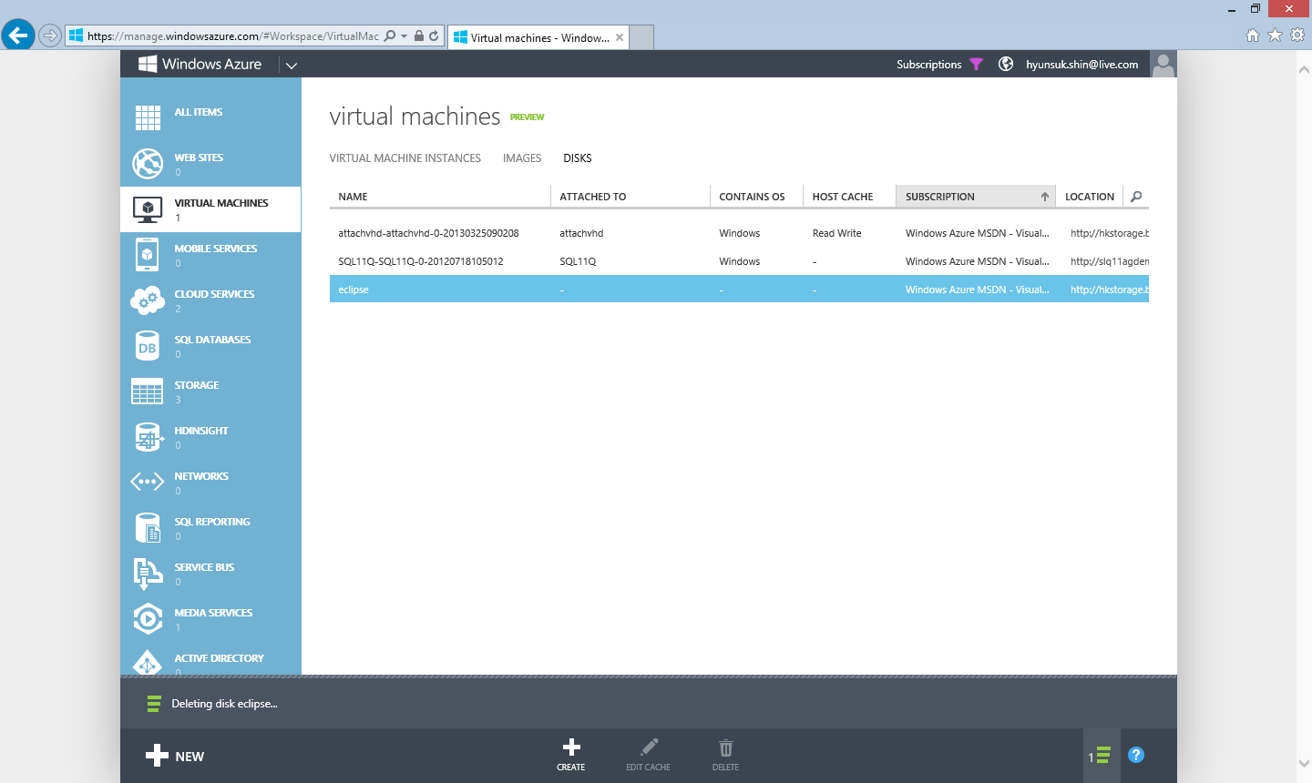
Selected disk will be removed

Slide 60

Job is done

Slide 61
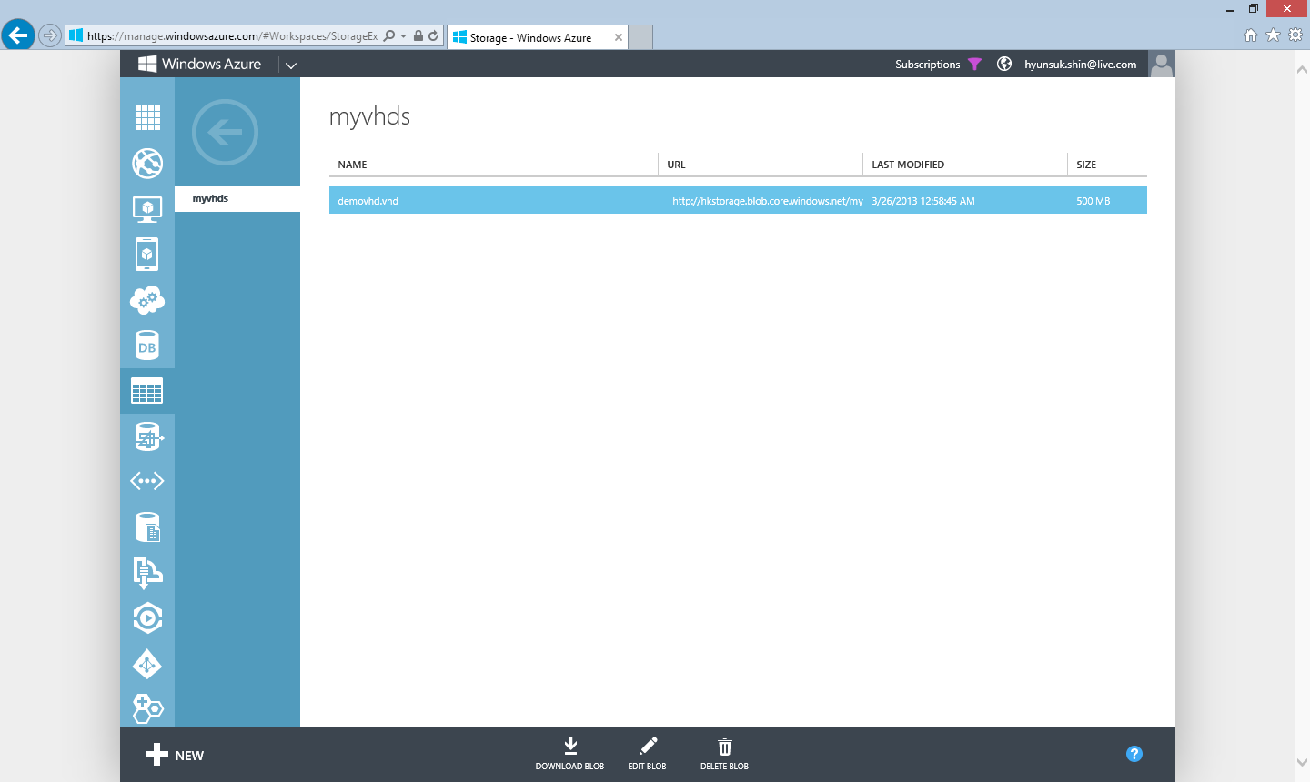
The VHD file is still remained

Slide 62
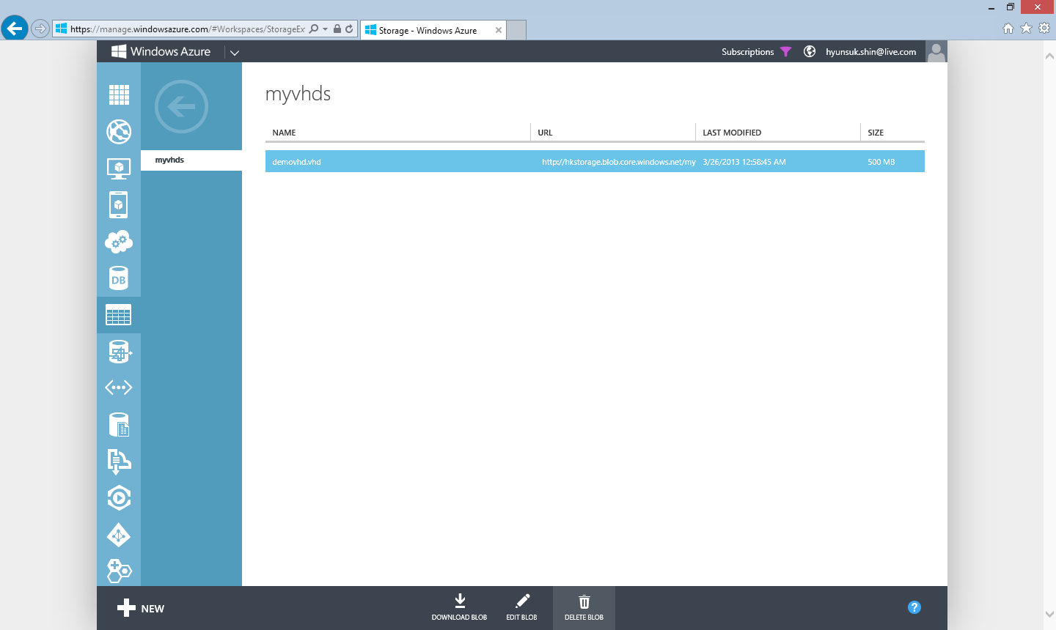
Selected file can be deleted by clicking “DELETE BLOBS”

Slide 63
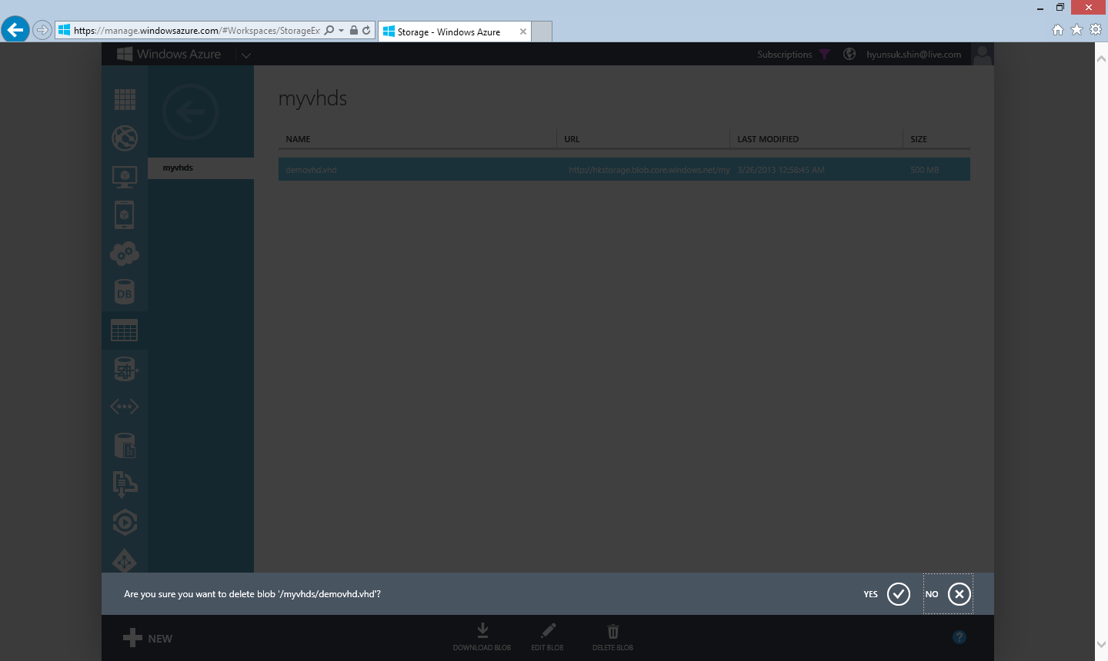
Confirm name of the file to delete VHD

